Slide 1



Collaborating with GitHub
for INTELLIGENT IOT DATA MANAGEMENT
BY: Srilakshmi Nair

Slide 2

1
why git and overview
Agenda
git setup
2
Topics Covered
3
clone and new branch
4
changes and push code

Slide 3



Why Use GitHub?
GitHub is used for version control and collaboration
Tracks code changes and allows teamwork
Everyone works in their own branch – no file conflicts
Pull Requests allow reviewing code before merging

Slide 4
GitHub Workflow Overview
Clone the repo
Create your own branch
Make changes locally
Show your work to Srilakshmi
Push to the main branch (after approval)

Slide 5
Git Setup
Install GIT INSTALL
Install VS Code
Set up Git (only once):
git config --global user.name "Your Name"
git config --global user.email "your@email.com"

Slide 6


Slide 7
Clone the repo
Open terminal or Git Bash
Run the following command:
git clone https://github.com/DataBytes-Organisation/Intelligent-IoT-Data-Management.git
Move into the project folder:
cd Intelligent-IoT-Data-Management
Open the project in VS Code:
code .

Slide 8
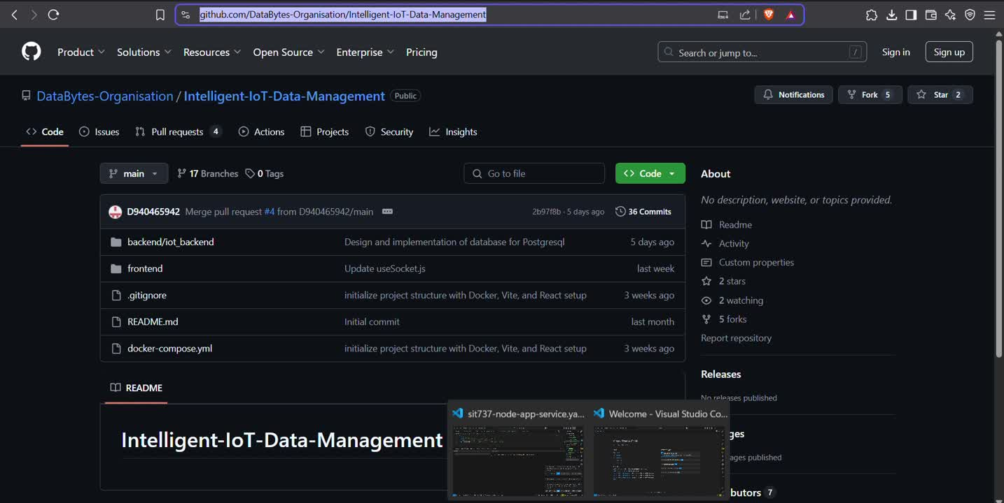

Slide 9
Create a New Branch
Why?
To keep the main branch clean and prevent code conflicts.
npm install axios
npm install vite --save-dev
Command:
git checkout -b your-name-feature
📌 Example:
git checkout -b srilakshmi-ui-page
Now you’re working on your own branch

Slide 10
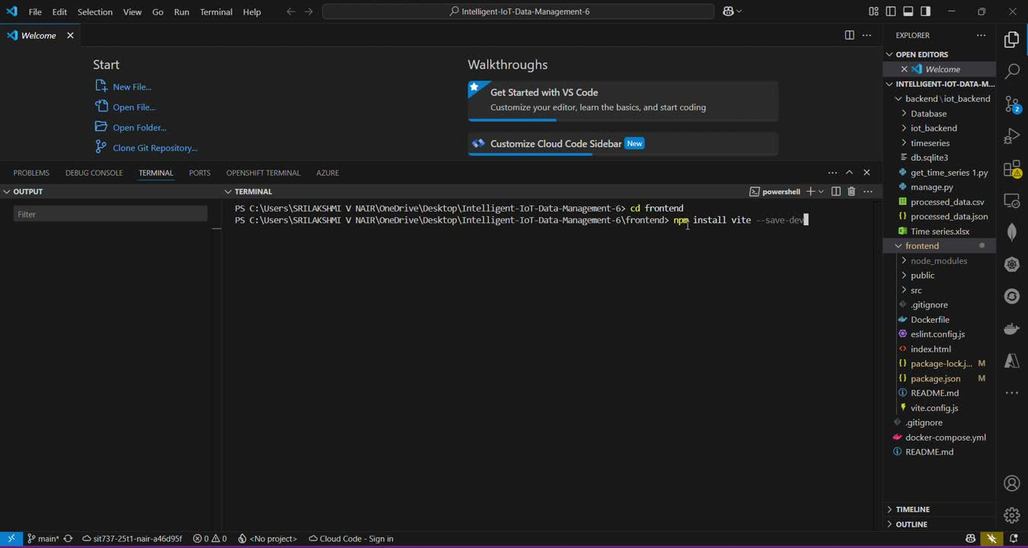

Slide 11
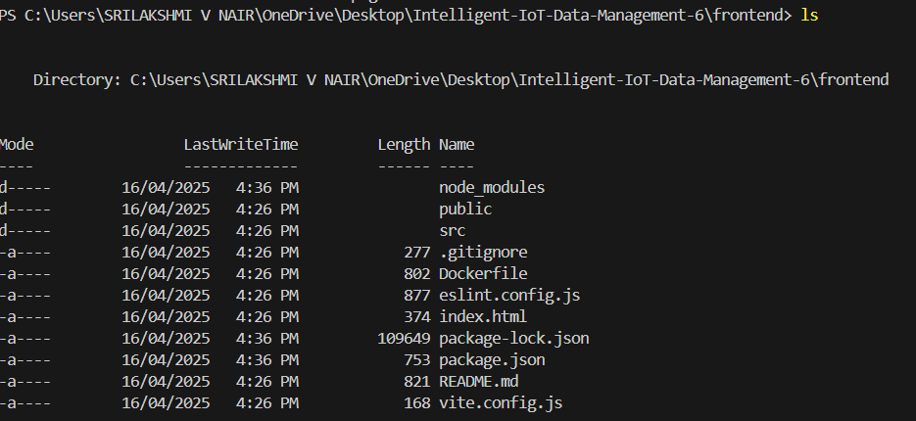
Make Your Changes
Add or edit files in the /frontend folder
Write your REACT/TAILWIND CSS/JS code
Save your work and test locally
🔍 Tip: Always check your work in the browser

Slide 12
Add, Commit, show
git add .
git commit -m “added login page UI”

Slide 13
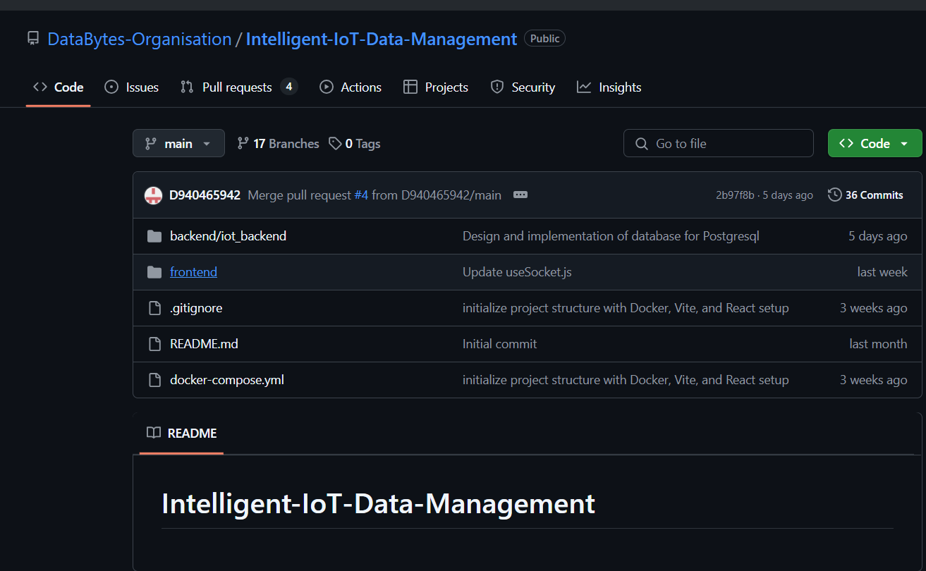
Push to Main (After Approval)
After your work is approved:
Switch to the main branch:
git checkout main
Pull latest changes:
git pull origin main
Merge your branch into main:
git merge your-name-feature
Push to GitHub:
git push origin main
Notes:
happy with your work in your created branch, you can add your command in vs terminal
git add .
git comit -m "added.."

Slide 14
Good Practices
Pull latest main before you start work
Make small, focused changes
Write clear commit messages
Don’t push without approval
Ask if you’re unsure – collaboration matters!

Slide 15



NEED HELP
🧠 Ask me any time!
Meetings, Teams, or chats
📩 Email: s223970328@deakin.edu.au
🔗 Repo Link:
https://github.com/DataBytes-Organisation/Intelligent-IoT-Data-Management
Youtube link:https://www.youtube.com/watch?v=PzYxpncAYD8

